Slide 1
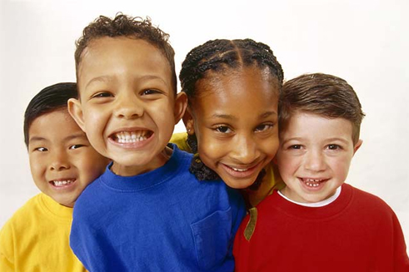

RESPECT
Treat others how you would like to be treated.

Slide 2
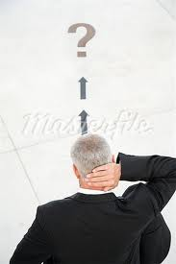
What is RESPECT?

Slide 3
How can you show RESPECT?
Be kind to one another.
Say nice words like, “Please” and “Thank You.”
Help someone who needs it.
Listen nicely to the speaker.

Slide 4
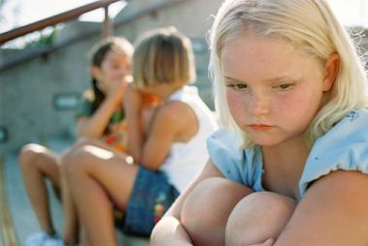
Is this being Respectful?

Slide 5
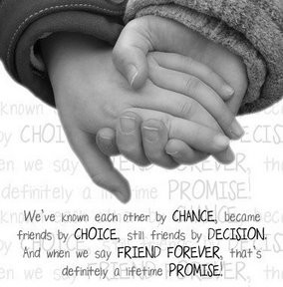
Think about how YOU can be RESPECTFUL!

